Slide 1
Foundation of Statistics

Slide 2
There are three kinds of lies: lies, damned lies, and statistics.
- Mark Twain / Benjamin Disrael

Slide 3
Why Study Statistics?
Statistics are part of your daily life and are all around you.
• Data Gathering
• Data Understanding
• Data Analysis/Interpretation
• Data Presentation

Slide 4
Statistical Terminology

Slide 5
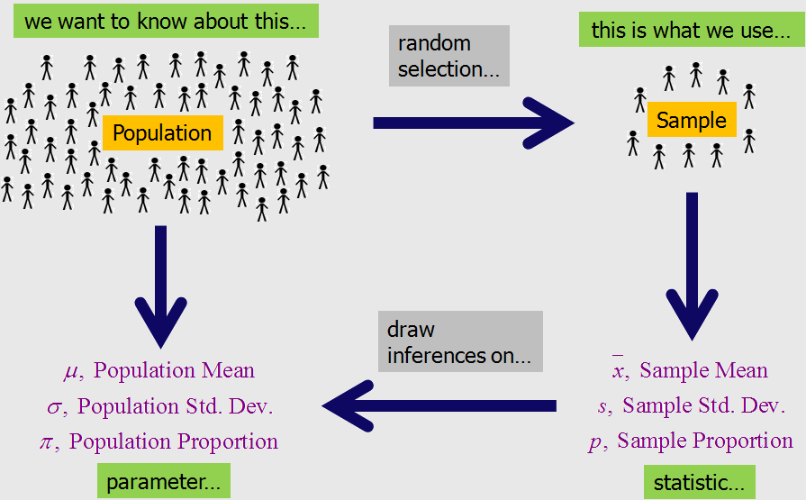
Population and Sample
Reference : http://www.dxbydt.com/the-size-of-your-sample/

Slide 6
Census and Survey
Census:
Gathering data from the whole population of interest. For example, elections, 10-year census, etc.
Survey:
Gathering data from the sample in order to make conclusions about the population.
For example, opinion polls, quality control checks in manufacturing units, etc.

Slide 7
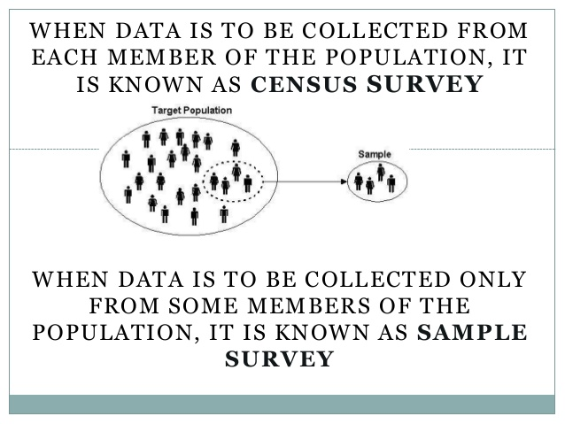
References : https://www.slideshare.net/SunilChichra/introduction-28293803

Slide 8
Parameter and Statistic
Parameter: A descriptive measure of the population.
For example, population mean, population variance, population standard deviation, etc.
Statistic: A descriptive measure of the sample.
For example, sample mean, sample variance, sample standard deviation, etc.

Slide 9
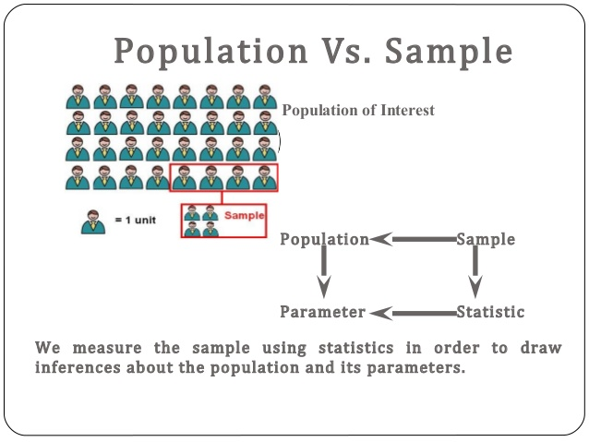
Reference : https://www.slideshare.net/drbhushankamble/sampling-and-its-variability

Slide 10
Identify Population Data or Sample Data?
The US Government takes a census of its citizens every 10 years to gather information.
a) Population b) Sample
You want to know what sports teens prefer so you send out a survey to all the students in your high school.
a) Population b) Sample
You want data on the shoe size of all West students, so you interview every student at school.
a) Population b) Sample

Slide 11
Identify as Parameter or Statistics?
You want to know the mean income of the people who subscribe to People magazine, so you question 100 subscribers.
a) Parameter b) Statistic
You want to know the average height of the students in this math class, so you have everyone in the class write their height on a sheet of paper.
a) Parameter b) Statistic

Slide 12
Parameter and Statistics
Greek – Population Parameter
Mean – μ
Variance – σ²
Standard Deviation - σ
Roman – Sample Statistic
Mean – x̅
Variance – s²
Standard Deviation - s

Slide 13
Descriptive and Inferential Statistics
Descriptive Statistics
Data gathered about a group to reach conclusions about the same group.
Inferential Statistics
Data gathered from a sample and the statistics generated to reach conclusions about the population from which the sample is taken. Also known as Inductive Statistics.

Slide 14
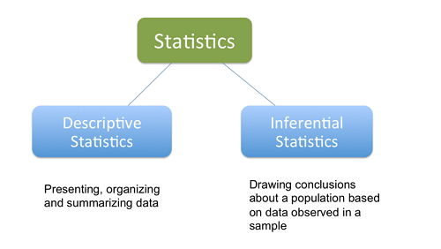
Reference: http://www.differencebetween.net/language/words-language/difference-between-descriptive-and-inferential-statistics/

Slide 15
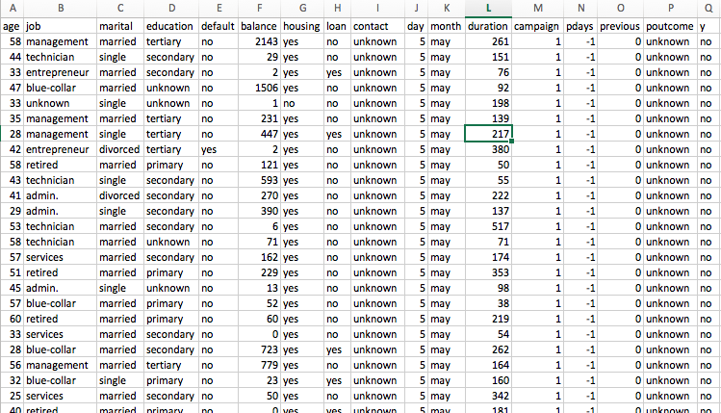
Variables and Data

Slide 16
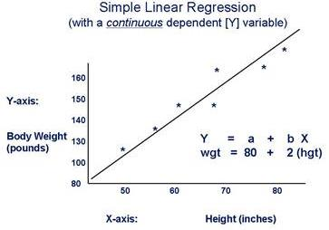
Variables – Dependent and Independent
• Dependent variables on y-axis and Independent on x-axis.
• Dependent variable also called Target variable or Class variable.

Slide 17
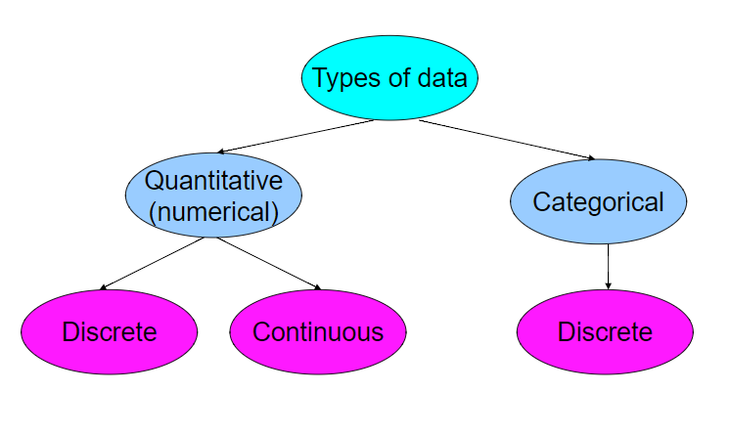

Slide 18
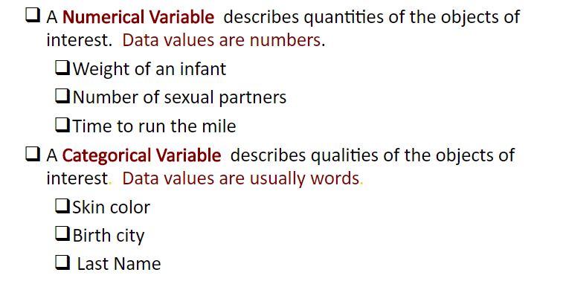
Data – Numeric and Categorical

Slide 19
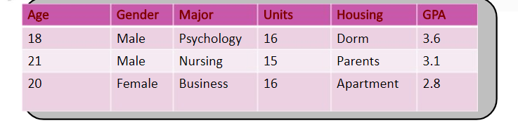
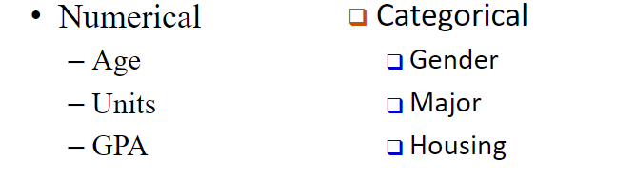
Numerical or Categorical?

Slide 20
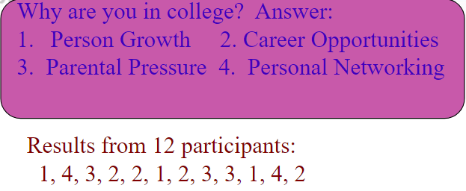
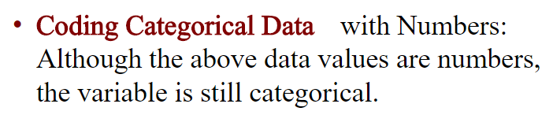

Numerical or Categorical?

Slide 21
Categorical Data (Qualitative)
Nominal Examples
• Employee ID
• Gender
• Religion
• Ethnicity
• Pin codes
• Place of birth
• Aadhaar numbers
Ordinal
Examples
• Mutual fund risk ratings • Fortune 50 rankings
• Movie ratings
While there is an order, difference between consecutive levels are not always equal.

Slide 22
Numeric Data (Quantitative) Examples
• Height
• Weight
• Time
• Volume
• Number of iPads sold
• Number of complaints received at the call centre • Number of employees
• Percentage return on a stock
• Rupee change in stock price

Slide 23
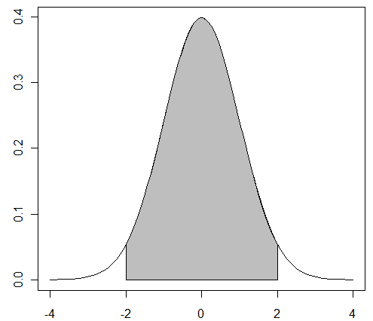
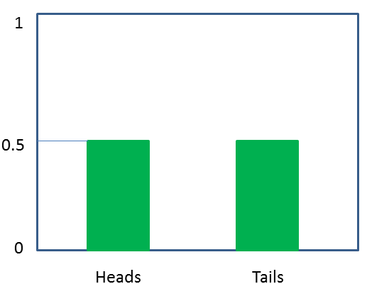
Discrete and Continuous
Countable
Measurable

Slide 24
Discrete or Continuous?
Time between customer arrivals at a retail outlet - Continuous
Sampling 100 voters in an exit poll and determining how many voted for the winning candidate -Discrete
Lengths of newly designed automobiles - Continuous
No. of customers arriving at a retail outlet during a five- minute period - Discrete
No. of defects in a batch of 50 items -Discrete

Slide 25
DESCRIBING DATA THROUGH STATISTICS

Slide 26
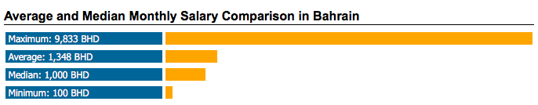
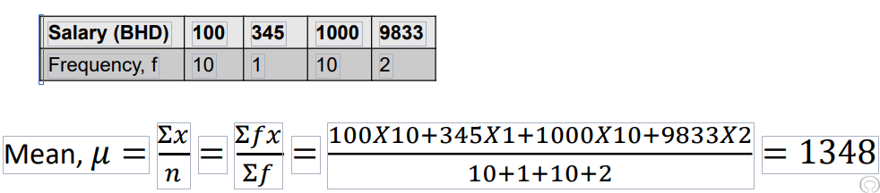
The Central Tendencies

Slide 27
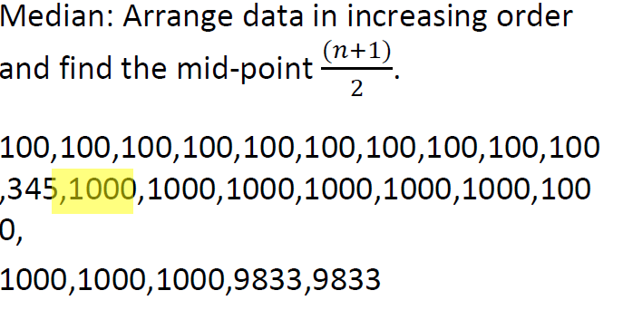
The Central Tendencies

Slide 28
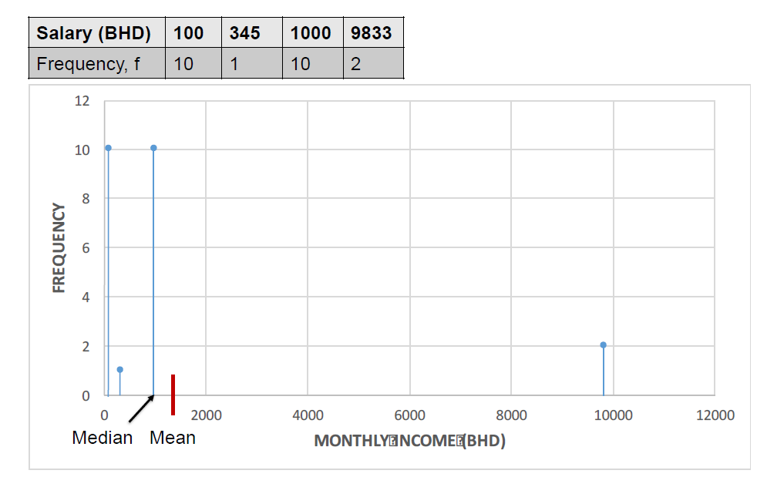
The Central Tendencies

Slide 29
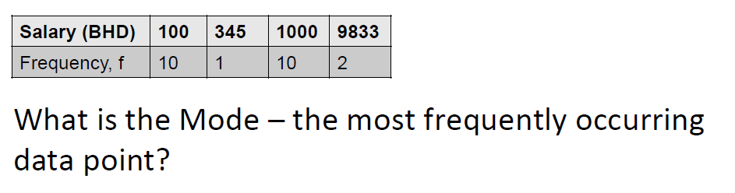
The Central Tendencies

Slide 30
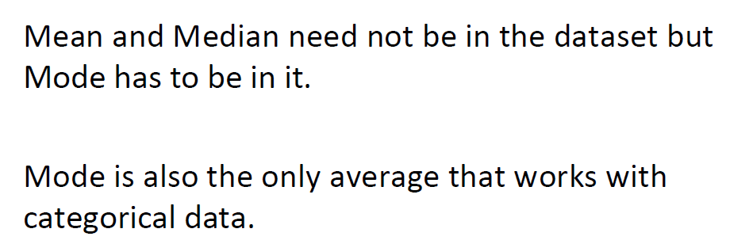
The Central Tendencies

Slide 31
The Central Tendencies
The management of Good Heart Inc. wants to give all its employees a raise. They are unable to decide if they should give a straight Rs2000 to everyone or to increase salaries by 10% across the board. The mean salary is Rs50,000, the median is Rs20,000 and the mode is Rs10,000.
How do these central tendencies change in both cases?
All increase by its proportion of increase in each employee

Slide 32
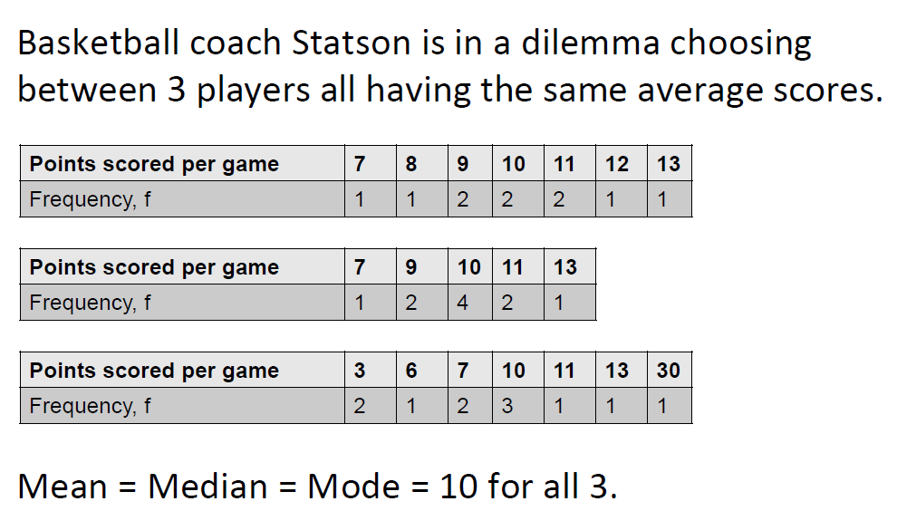
Measuring Variability of Spread

Slide 33
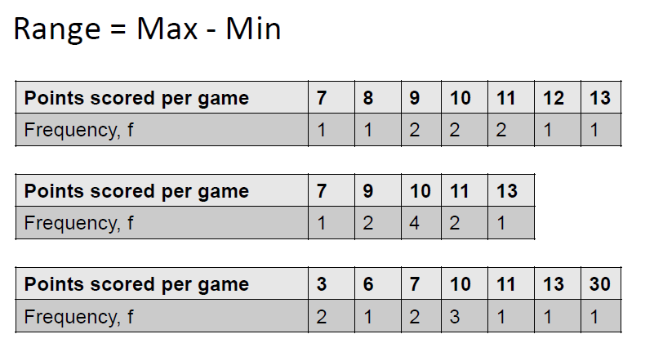
Measuring Variability of Spread

Slide 34
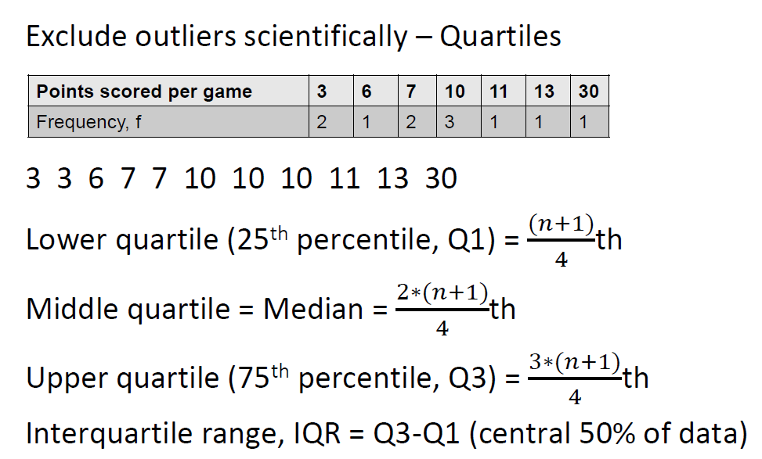
Measuring Variability of Spread

